Slide 1



Slide 2





ONGOING MISSION INITIATIVES

Slide 3

External Audience
Internal Audience

Slide 4


ALL THINGS NEW IS WHAT WE WILL PROCLAIM WITH ONE VOICE IN 2027.

Slide 5
4 AREAS OF FOCUS

Slide 6
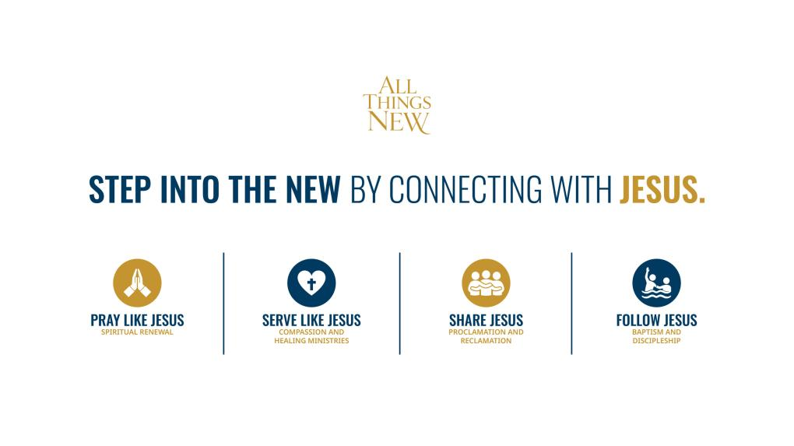

Slide 7
INITIATIVE TIMELINE
LAUNCH
DAY OF PRAYER
SERVE
LIKE JESUS
PUBLIC
EVENTS
Sept 5
2026
Jan '27
Aug '27
Sept '27
PRAY
LIKE JESUS
SHARE
JESUS
FOLLOW
JESUS
Sep '26
Mar '27
Apr '27
Sep '27
Oct '27
Dec '27
Phases overlap intentionally — momentum builds as each area reinforces the next.
Notes:
33

Slide 8

MEDIA EFFORTS

Slide 9

NAD WIDE CHURCH-BASED
SOCIAL MEDIA CAMPAIGN

Slide 10






ONE VOICE
MANY SPEAKERS
What if ... hundreds of thousands of people saw their social media feed flooded with the same evangelistic post from an Adventist friend or a local church (at the same time) …
What if ... every church, school, and institution in the NAD had properly branded, quality evangelistic content to post from January to December 2027...
What if ... thousands of Adventist church members learned how to answer questions about their faith on social media?
What if ... we could teach thousands of Adventist churches how to have a quality evangelistic presence online—all while witnessing to their communities?

Slide 11
What if... we could do all of this, working from the ground up?
IN 4 STEPS

Slide 12
STEP 1
NAD (COM, MIN, Youth & PS) meets with union and conf Ministerial and COM directors and hash out details. Each union is assigned a month.
STEP 2
NAD provides templates. Unions work with conferences and select local churches to produce 15 pieces of content for their designated month.
PROCESS
STEP 3
Unions send content back to NAD. PS, COM & MIN edit. COM and PS select 10 best posts, create hashtag/captions, cadence, and label posts. Then send to unions. Ad boosting outlined.
STEP 4
Unions send to conf; conf distribute to churches. Flame/Bible symbol; and they can add logoed end cards as needed/approved. Churches schedule post for specified day/time.
Step 4

Slide 13
1
2
3
NAD
UNIONS & CONFERENCES
LOCAL CHURCH
Provides:
    Templates
    Quality control
    Captions
    Coordination & strategy
    Training (in-person, Zoom, ALC)
Provides:
    Content
    Distribution
    Support
Provides:
    Content (if called upon)
    Engagement and DM answers
Receives
    90+ Pieces of Content
    Training
Step 4

Slide 14
4 STATIC POSTS
CONTENT
REQUESTED
3 CAROUSELS
4 REELS
3 STORIES
Step 4

Slide 15
TOTAL POST
120+
Total Posts Given to Each Participant
CONTENT GIVEN
LANGUAGES
  NAD will provide translation for static content.
  Unions will provide reels in various languages: English, Spanish & French.
  NAD can assist with French.
3
Step 4

Slide 16

THE TRACKING
Adventist Connect will provide Thrive to every church to track interests. interest tracker for churches. And every month starting in July, NAD, union, and conference teams meet together to pray and strategize and share updates via Zoom. In 2027, they share monthly updates on statistics.
Step 4

Slide 17
FUTURE ROADMAP
1
STAGE 1
STAGE 2
STAGE 3
STAGE 4
JUN 2026
JUL-AUG 2026
SEPT-DEC 2026
JAN-SEPT 2027
PITCH
PREP
PRODUCE
PREACH
Step 4

Slide 18

ONE CHURCH STRUCTURE, SHARED MISSION
From local church to GC
Local churches make it personal
Conferences and unions coordinate
Divisions support and contextualize
GC helps provide shared direction
Our structure becomes a mission advantage.

Slide 19

GC WEB PLATFORM
One clear destination for interests
The platform will help people:
Submit prayer requests
Request Bible studies
Find a local church
Request a book
Connect with a digital missionary

Slide 20

FOLLOW-UP: WHERE INTEREST BECOMES CARE
Thrive + Adventist Connect
Capture the interest
Route it to the right place
Support local church follow-up
Equip members for online evangelism
Digital response becomes personal ministry.

Slide 21

DISCOVERING JESUS SERIES
A media campaign designed to highlight the
hope, healing, and transformative
power of Jesus.
Created for non-Christian and former Christian viewers
Notes:
30

Slide 22
FOUR SHORT FILMS TIED TO MAJOR SEASONS
Christmas 2026
Short film celebrating the gift of Jesus
Easter 2027
Short film celebrating Jesus’ sacrifice
Summer 2027
Short Film encouraging mental health
awareness
Fall 2027
Short film commemorating
the baptism of Jesus
Notes:
30

Slide 23

MARKETING

Slide 24
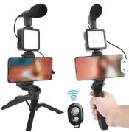
  Welcome Resource Kit
    Tripod/Camera/Microphone
    Digital Media Prompts Card
    Magnetic Bookmark
    T Shirt
  Adventist Connect and Thrive
  Access to Digital Media Library
REGISTRATION
www.nadadventist.org/allthingsnew
Notes:
32

Slide 25
SCREEN SHOT
REGISTRATION FORM

Slide 26

SHARING BOOK
JESUS MAKES ALL THINGS NEW

Slide 27
JESUS MAKES ALL THINGS NEW
Content
Chapters
Pages
Offer
Goal
Member invitation
9 selected chapters from the Desire of Ages
1, 4, 52, 74, 75, 77, 78, 79, 81
128
Christ-centered Bible study series
5 million shares
Share with 10 people

Slide 28
JESUS MAKES ALL THINGS NEW
Pre-publication Orders
Cost
Delivery
Pallets
Shipping
Deadline
By Conference
Under $1
by pallet to the Conference/Major Centers
48 cases of 100/Total of 4800
Pre-orders covered by NAD
To be announced

Slide 29


MISSIONAL SMALL GROUPS

Slide 30
Authentic Community
Evangelistic Effectiveness
Retention After Baptism
Improved Attendance
Intentional Discipleship
Leadership Development
Revitalization
Church Multiplication
BENEFITS OF MISSIONAL
SMALL GROUPS
Step 4

Slide 31




MISSIONAL SMALL GROUPS MEETING IN
Homes | Online | College Campuses | Restaurants
Garages | Churches | Other settings

Slide 32

PRAY LIKE JESUS
IN SMALL GROUPS
Study Jesus’ prayer life in the Gospels
Open and close with prayer
Practice ACTS prayer (Adoration, Confession, Thanksgiving, Supplication)
Keep a group prayer journal (record answered prayers)
Pray for the “empty chair”

Slide 33

SERVE LIKE JESUS
IN SMALL GROUPS
Study Jesus’ ministry of healing and compassion
Choose a local service project
Visit, support, and encourage people in need
Pray for healing and restoration
Host a healing prayer night - invite neighbors and friends

Slide 34

SHARE JESUS
IN SMALL GROUPS
Share personal testimonies with group
Practice gospel conversations with secular people
Create “100 people” list - each member writes names
of people they want to reach
Host a “Come Back” dinner in group – invite
someone who left church
Invite others to come back to Jesus

Slide 35

FOLLOW JESUS
IN SMALL GROUPS
Invite group members to make a decision for baptism
Plan for the whole group to attend each other’s baptism
Pair new believers with mentors
Train future group leaders
Multiply groups to reach more people

Slide 36
LAUNCH DATE
SEPTEMBER 5, 2026

Slide 37
EVANGELISM FUNDING OPTIONS
SHARING
BOOK
LOCAL CHURCH SOCIAL MEDIA
Notes:
39

Slide 38
1
Pray for All Things New
Join the Day of Prayer — Sept 5, 2026
2
Read or Listen to Jesus Makes All Things New
Abridged edition available in print + audio
KEY ELEMENTS
3
Share the Jesus Makes All Things New Book
Share to 10 people in your circle
4
Share Jesus Digitally
Use your digital media kit — post, story, reel
5
Invite Someone to Church Events
Public events launching in 2027
Notes:
40

Slide 39
Q&A

Slide 40


www.nadadventist.org/allthingsnew

